Slide 1
Software Documentation on
CODELEARNERSHUB
Event Management System (EMS) App
OLALEKAN SAHEED O.
MARCH 2022.

Slide 2
The Problem Statement
Planning an event has its fair share of struggles, no matter what the size of the event. The followings include but not limited to the problems facing :
Having more attendees or guests more than what planned for is an unavoidable mistakes.
Managing extra people is a huge issue as it can completely destroy an event if not done in a proper manner.
Overspending on the event is a big event challenge.
Having not a structured event management process can be an event mishap.
Failure to capture valuable event data can be an event mishap.
Over planning an event schedule is another problem.

Slide 3
CURRENT STATE
It is obvious that keeping up with the new trends in technological advancement has become a very difficult task these days. Monitoring social media and the relevant channels for updates can be tough.
However, is very important to keep doing that so that knowing anything and everything that might happen which can affect the event in any way. Try to think outside the box in terms of technology and use event –planning software to help.

Slide 4
APPLICATION OVERVIEW
Majorly, event success is largely determined by attendees satisfaction. Right from pre-event to event proper and to post-event. This App helps all event stakeholders to answer the age – old question: How was the event?
This App helps enhance event-goers' experience and also makes the event planner's life easier by making the event planning process more seamless. This App is a total solution to an event management.

Slide 5
APPLICATION SCOPE
The development of this App comes in phases. The initial design phase caters for event attendee with the convenience of having everything they need to know about the event in one place.
It also allows the users to plan their schedule ahead of time and be informed by push notification about event updates.

Slide 6
OBJECTIVES
To smooth workflow in the entire event lifecycle.
To manage distributed audiences in a single platform.
To gives room for easy event registration and check-in, both
on-site and online.
When it involves ticket sales, it makes the process trustworthy, short and hassle- free.
To keeps overheads cost lower.
To reduce or remove human emotional factor due to no face –to- face interaction.
To provides real-time analytics and reporting.

Slide 7
OBJECTIVES CONTINUED
To supervise numerous events effortlessly by running multiple events simultaneously.
To enhances attendee commitment occupied and alert by keeping the registrants up to date through planned remainders, newsletters and messages.
To create an avenue to share information with all attendees at once.
Unforeseen and last minutes changes to the event is can be easily catered for as people can be notified via push notifications.

Slide 8
FUNCTIONAL REQUIREMENTS

Slide 9
ATTENDEE’S FUNCTIONAL REQUIREMENT
The Attendee can register on the App which enable him or her to have full access to use App via login.
The Attendee can search for any event of interest on the App.
The Attendee can also register for an event.

Slide 10
Organizer’s Functional Requirement
Organizer can register in the App to use the App fully.
He can create a new event.
He can update an event earlier created.
If situation demands, he can delete the event if there is need to do so with the consent of the Admin.

Slide 11
Admin Functional Requirement
Smooth running of the App is the primary function of the Admin being the overall boss of the portal.
Admin registers and supervises all the activities on the portal.
The admin will validate and approve different users’ accounts.
He also validate and approve any event created on the portal.
Admin can create any category of event.
The Admin is also in the position to update, block and remove totally of any registered event that does not conform with the App policy or illegal.
The admin manage and monitor the revenue generated from the purchase of tickets.
He gives real time accounting details through analysis and reports.

Slide 12
NON FUNCTIONAL REQUIREMENT

Slide 13
TECHNICAL REQUIREMENT
SECURITY:
The app is protected from unauthorized access to the System . Users gain access through Email and password provided when registered and is expected of them not to disclose to third party.

Slide 14
TECHNICAL REQUIREMENT
DATA INTERGRITY: All the App stakeholders enjoy privacy of information. Attendee is not permitted to update or delete an event. Such attempt should be reported to the organizer or the Admin.

Slide 15
TECHNICAL REQUIREMENT
USABILITY REQUIREMENT:
The App is user’s friendly. Any one that operate internet phone can make use of the App without any special training.
USER INFORMATION: The App requires functional Email and password to work to the optimal. Hence the App really heavily on faithful information provided by the users.

Slide 16
APPLICATION ARCHITECTURE

Slide 17



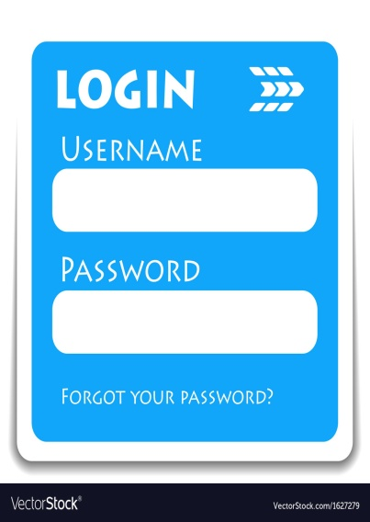




High Level Architecture
User
Server

Slide 18
Low Level Architecture

Slide 19
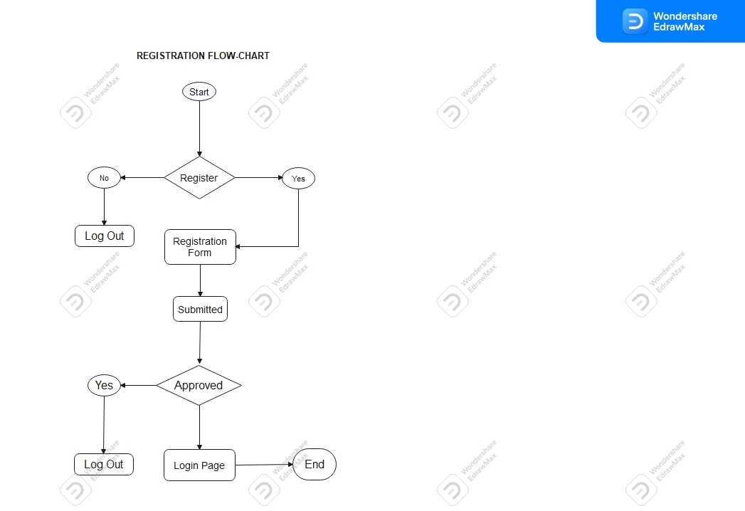

Slide 20
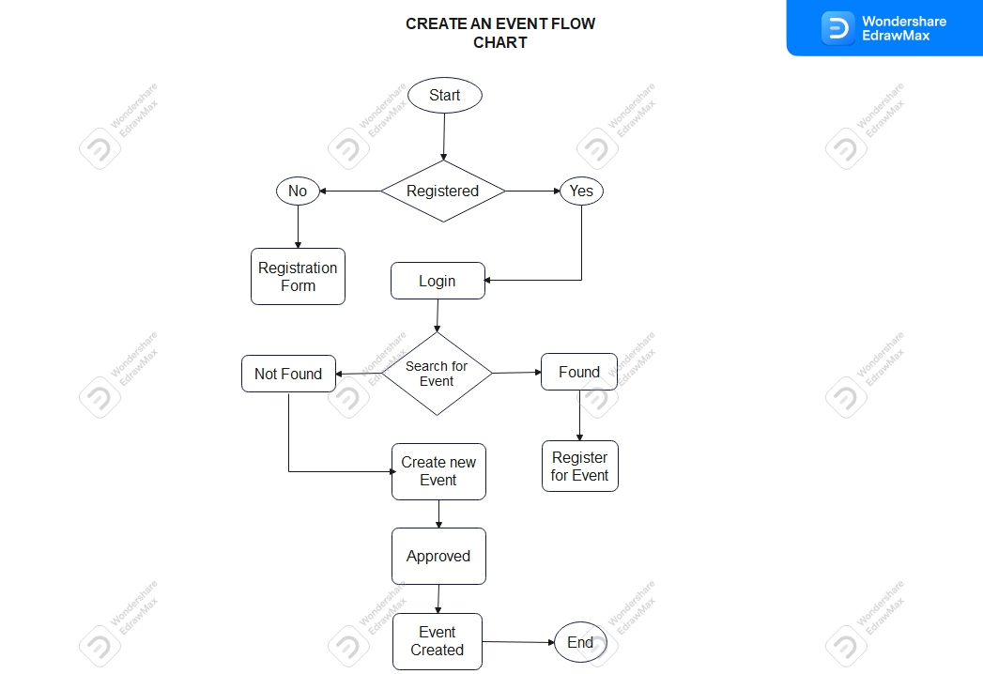

Slide 21
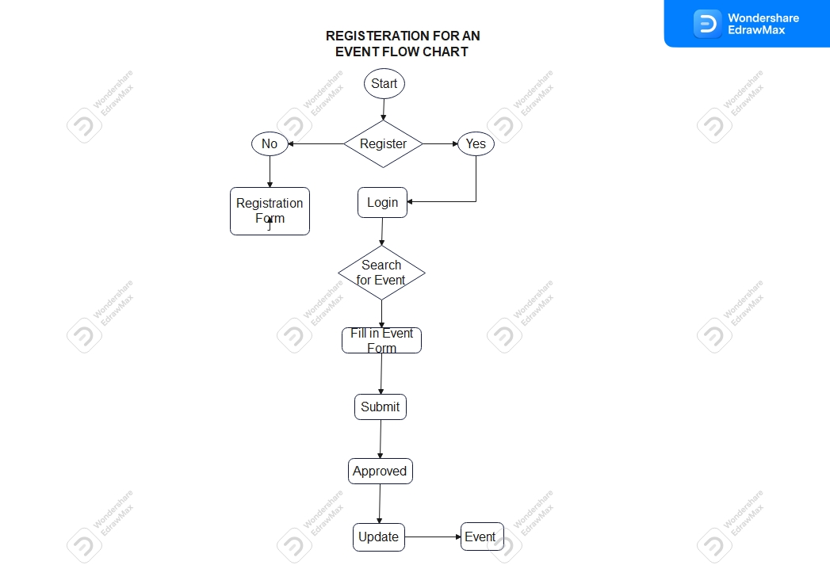

Slide 22
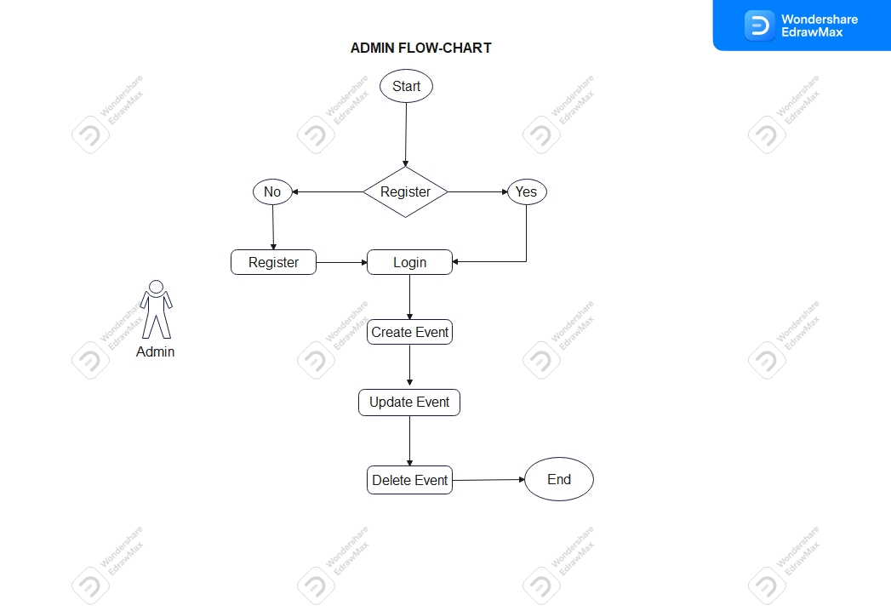

Slide 23
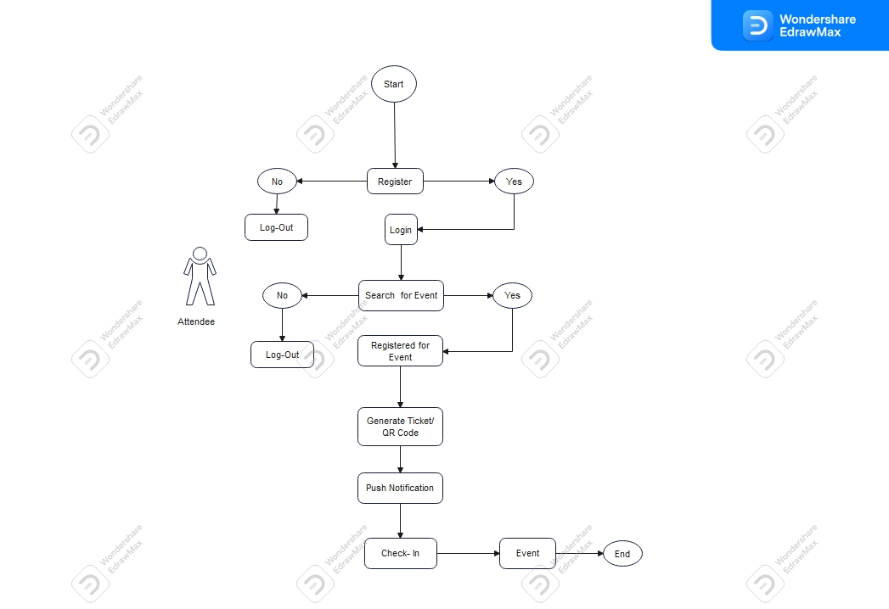
ATTENDEE FLOW CHART

Slide 24
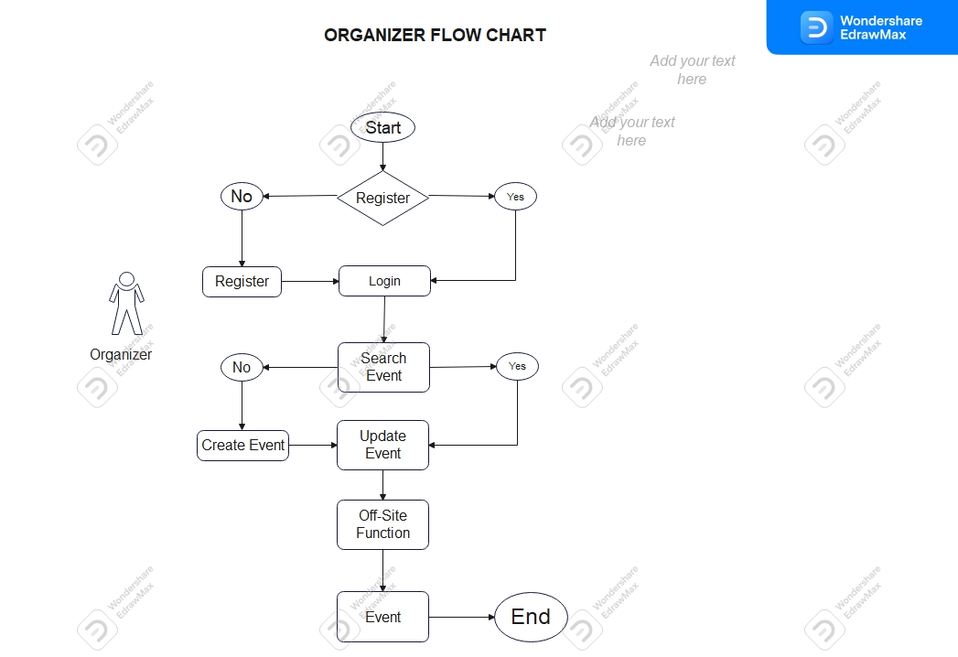

Slide 25
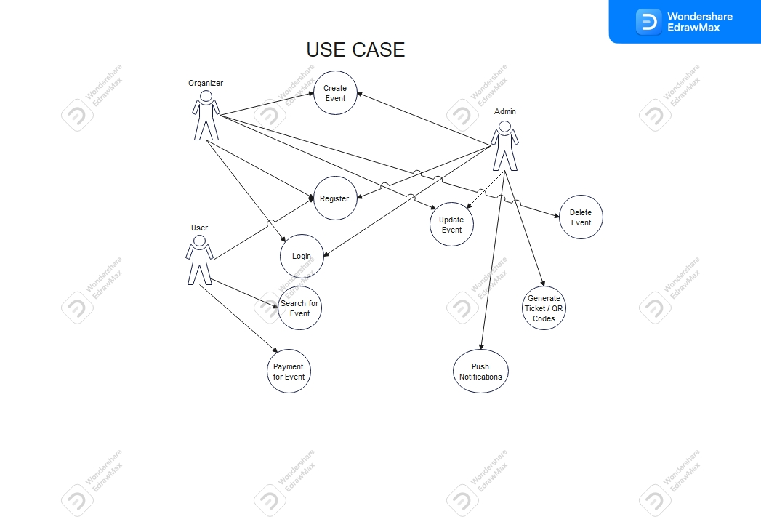
USE CASE

Slide 26
